Slide 1



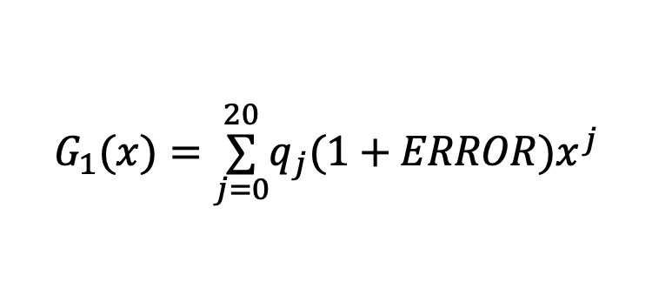
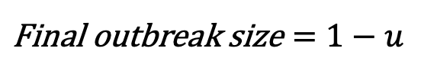
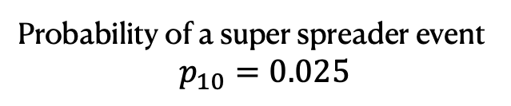
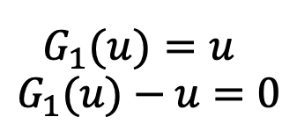
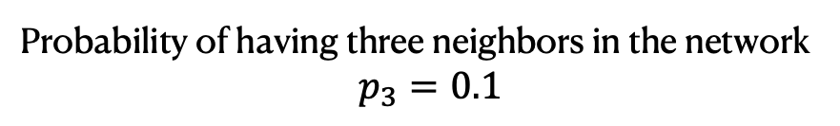
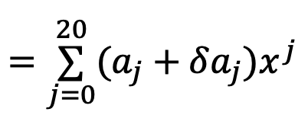
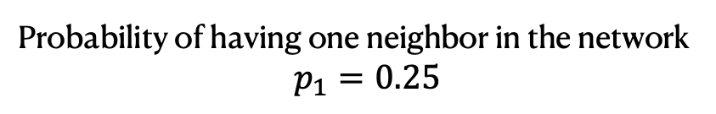
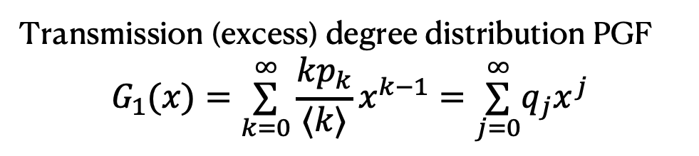
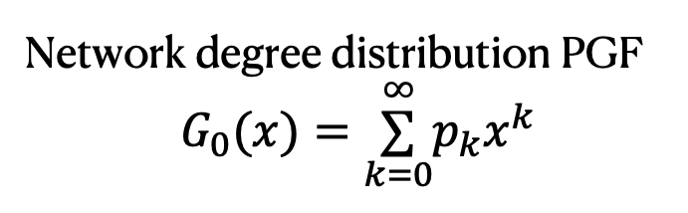
Sensitivity analysis of stochastic polynomials and its application to epidemic forecasts
Mariah C. Boudreau, Christopher M. Danforth, Jean-Gabriel Young and Laurent Hébert-Dufresne
How we do this:
Rationale:
Example secondary infection distribution
Probability of having one neighbor in the network
$p_{1}=0.25$
Incorporating heterogeneity in disease dynamics
Incorporating error into data into a model
Probability of having three neighbors in the network
$p_{3}=0.1$
Probability of k
Model with a distribution of secondary infections,
specifically probability generating functions (PGFs)
Probability of a super spreader event
$p_{10}=0.025$
Perturb degree distribution
k, secondary infections
Determine polynomial
coefficients from distribution
Transmission (excess) degree distribution PGF
$$G_{1}(x)=\overset{∞}{\underset{k=0}{∑}}\frac{kp_{k}}{⟨k⟩}x^{k−1}=\overset{∞}{\underset{j=0}{∑}}q_{j}x^{j}$$
Network degree distribution PGF
$G_{0}(x)=\overset{∞}{\underset{k=0}{∑}}p_{k}x^{k}$
Solving PGF with perturbed degree distribution
Take derivative
Add error to coefficients
$$G_{1}(x)=\overset{20}{\underset{j=0}{∑}}q_{j}(1+ERROR)x^{j}$$
$$G_{1}(u)=u$$
$$G_{1}(u)−u=0$$
Determine the sensitivity of certain degree distributions when solving for outbreak sizes
Solve the self consistent equation
$$=\overset{20}{\underset{j=0}{∑}}(a_{j}+δa_{j})x^{j}$$
Solve for final
outbreak size
C. Dye, and N. Gay, Modeling the SARS epidemic. Science 300.5627 (2003): 1884-1885.
Do this over and over again for
differing ERROR distributions
$$\text{Final} \text{outbreak} \text{size}=1−u$$
M.E. Newman, S.H. Strogatz, and D.J. Watts, Random graphs with arbitrary degree distributions and their applications, Physical Review E 64, 026118 (2001).

Slide 2
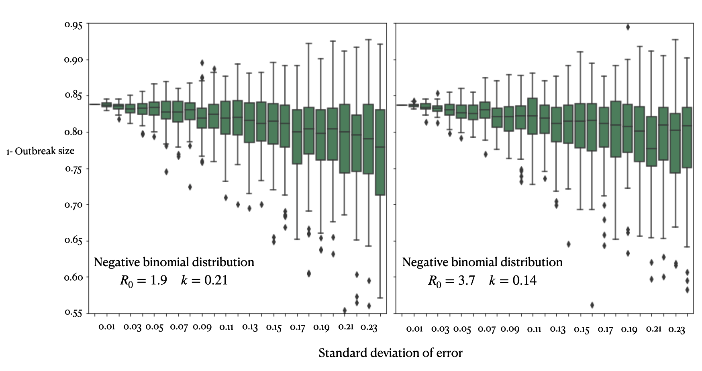
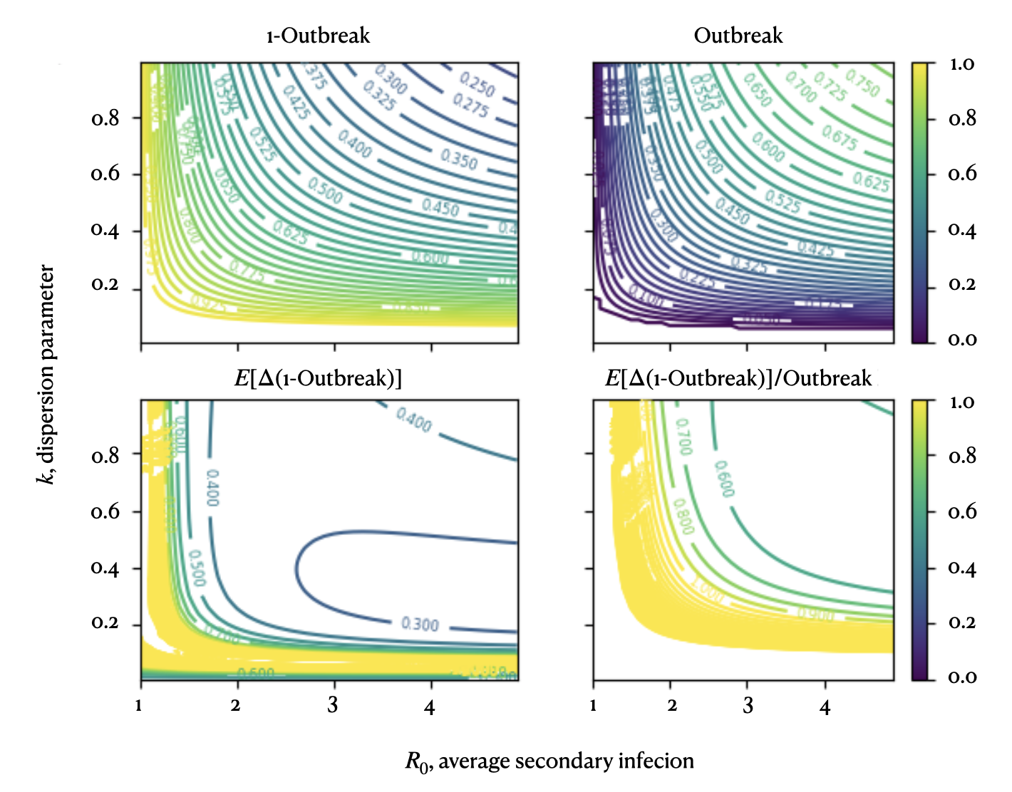
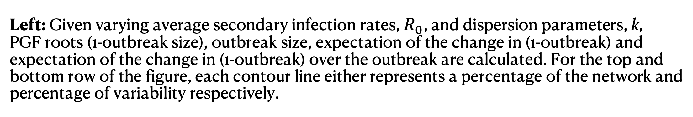
Right: Two systems, homogenous and heterogenous, exhibit how added error
create varying final outbreak sizes as more error is added to the system. The
box plots grow larger and outbreak sizes vary more on the left (homogeneous) plot
compared to the the left (heterogeneous).
Take away: Outbreak sizes can vary with more homogeneous secondary
degree networks, meaning they are more sensitive to errors in data.
Left: Given varying average secondary infection rates, $R_{0}$, and dispersion parameters, k,
PGF roots (1-outbreak size), outbreak size, expectation of the change in (1-outbreak) and
expectation of the change in (1-outbreak) over the outbreak are calculated. For the top and
bottom row of the figure, each contour line either represents a percentage of the network and
percentage of variability respectively.
Take away: When keeping outbreak size constant, the expectation of the change in
(1-outbreak) is more drastic and sensitive for smaller outbreaks.
J.O. Lloyd-Smith, S. Schreiber, P. Kopp, et al., Superspreading and the effect of individual variation on disease emergence. Nature 438.7066 (2005): 355-359.
Caption

Slide 3
Rationale:
Incorporating heterogeneity in disease dynamics
Incorporating error into data into a model
Model with a distribution of secondary infections,
specifically probability generating functions (PGFs)
Perturb degree distribution
Solving PGF with perturbed degree distribution
Determine the sensitivity of certain degree distributions when solving for outbreak sizes
C. Dye, and N. Gay, Modeling the SARS epidemic. Science 300.5627 (2003): 1884-1885.

Slide 4
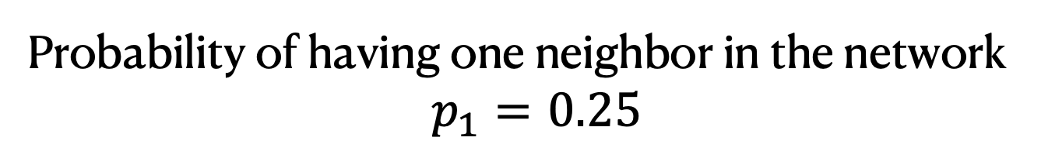
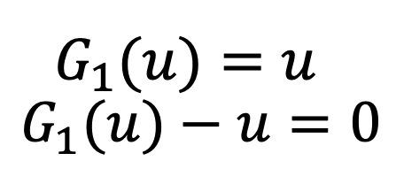
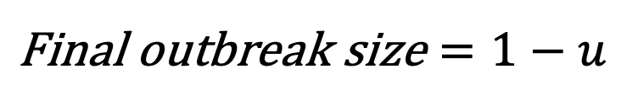
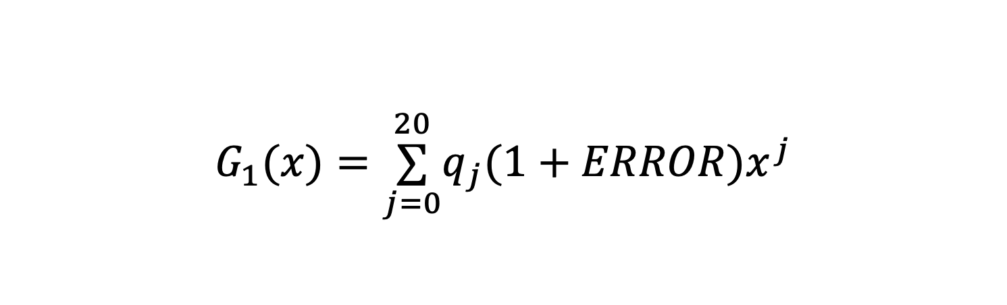
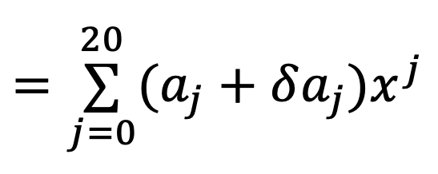
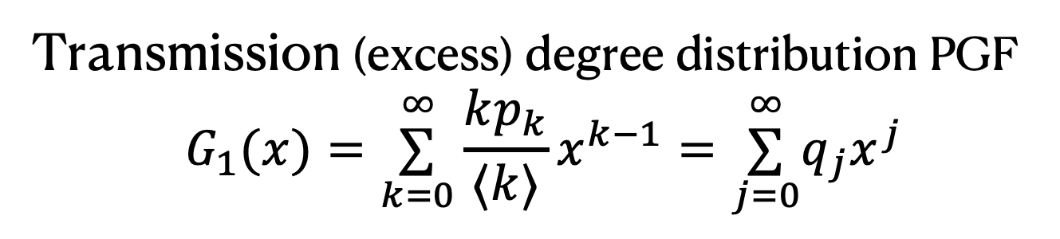
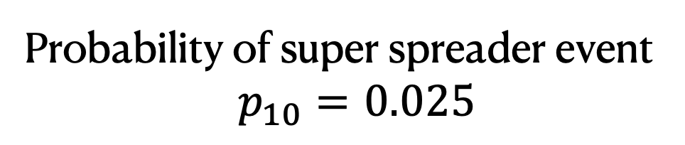
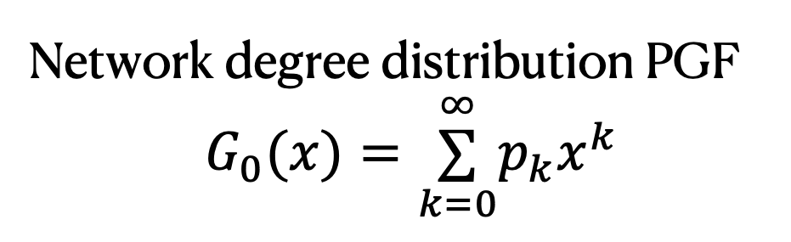
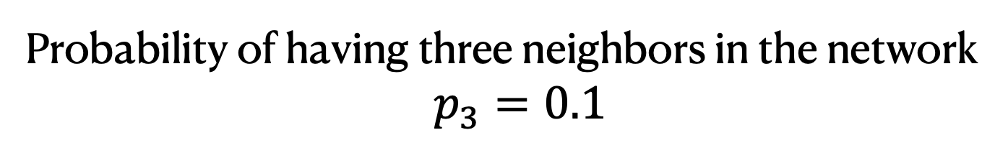
How we do this:
Example secondary infection distribution
Probability of having one neighbor in the network
$p_{1}=0.25$
Probability of k
Probability of having three neighbors in the network
$p_{3}=0.1$
Probability of super spreader event
$p_{10}=0.025$
k, secondary infections
Determine polynomial coefficients from distribution
Network degree distribution PGF
$G_{0}(x)=\overset{∞}{\underset{k=0}{∑}}p_{k}x^{k}$
Transmission (excess) degree distribution PGF
$$G_{1}(x)=\overset{∞}{\underset{k=0}{∑}}\frac{kp_{k}}{⟨k⟩}x^{k−1}=\overset{∞}{\underset{j=0}{∑}}q_{j}x^{j}$$
$$G_{1}(x)=\overset{20}{\underset{j=0}{∑}}q_{j}(1+ERROR)x^{j}$$
Take derivative
Add error to coefficients
$$=\overset{20}{\underset{j=0}{∑}}(a_{j}+δa_{j})x^{j}$$
Solve the self consistent equation
Solve for final
outbreak size
$$G_{1}(u)=u$$
$$G_{1}(u)−u=0$$
Do this over and over again for differing ERROR distributions
$$\text{Final} \text{outbreak} \text{size}=1−u$$
M.E. Newman, S.H. Strogatz, and D.J. Watts, Random graphs with arbitrary degree distributions and their applications, Physical Review E 64, 026118 (2001).

Slide 5
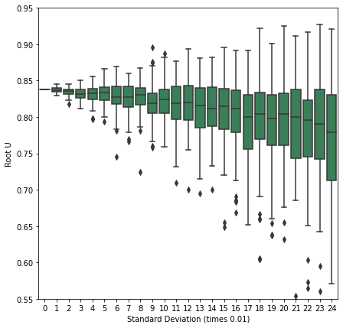
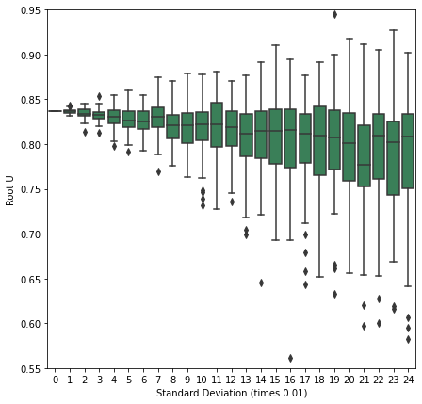
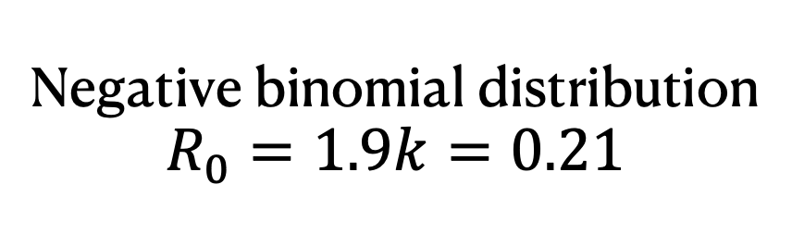
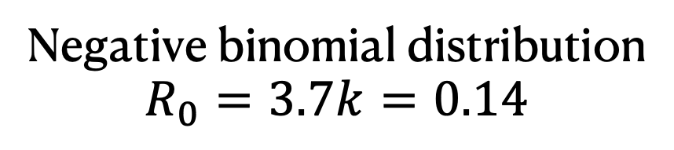
0.95
0.90
0.85
0.80
1- Outbreak size
0.75
0.70
0.65
Negative binomial distribution
$$R_{0}=1.9k=0.21$$
Negative binomial distribution
$$R_{0}=3.7k=0.14$$
0.60
0.55
0.01
0.03
0.05
0.07
0.09
0.11
0.13
0.15
0.17
0.19
0.21
0.23
0.01
0.03
0.05
0.07
0.09
0.11
0.13
0.15
0.17
0.19
0.21
0.23
Standard deviation of error
J.O. Lloyd-Smith, S. Schreiber, P. Kopp, et al., Superspreading and the effect of individual variation on disease emergence. Nature 438.7066 (2005): 355-359.

Slide 6
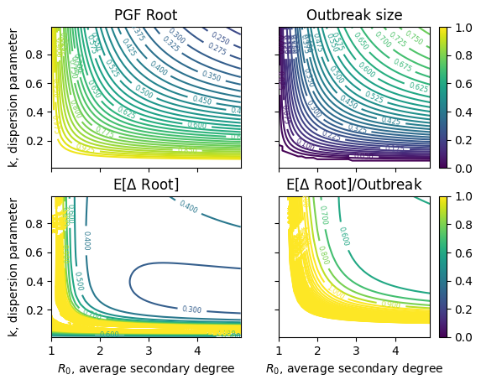
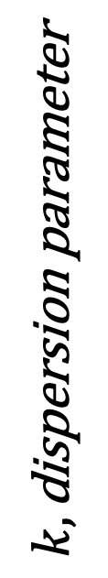
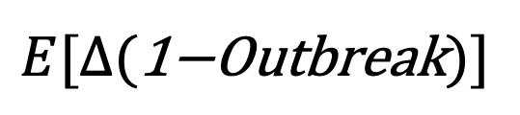
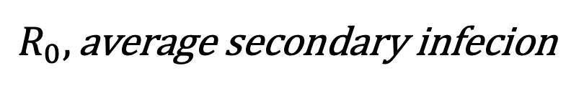
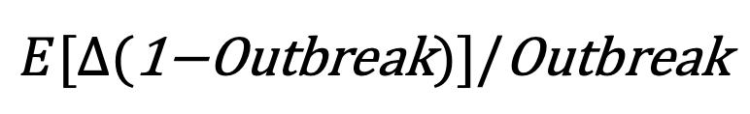
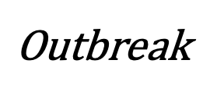
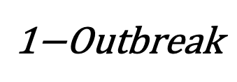
$$\text{1−}\text{Outbreak}$$
$$\text{Outbreak}$$
1.0
0.8
0.6
0.4
0.2
0.0
0.8
0.6
0.4
0.2
$$k,\text{dispersion} \text{parameter}$$
$$E[Δ(\text{1−}\text{Outbreak})]$$
$$E[Δ(\text{1−}\text{Outbreak})]/\text{Outbreak}$$
1.0
0.8
0.6
0.4
0.2
0.0
0.8
0.6
0.4
0.2
1
2
3
4
1
2
3
4
$$R_{0},\text{average} \text{secondary} \text{infecion}$$

